Slide 1
Microservices, DevOps, much more – Endless story of Containers
Saravanan Devendran
Member of IBM AoT, STSM, Chief Architect.

Slide 2
Developers job got simplified & initial cost of development got significantly reduced in the last decade with Containers & Microservices

Slide 3
Microservices Overview: What & Why ?

Slide 4
What is Microservices https://www.martinfowler.com/articles/microservices.html
The term "Microservice Architecture" has sprung up over the last few years to describe a particular way of designing software applications as suites of independently deployable services.
In short, the microservice architectural style is an approach to developing a single application as a suite of small services, each running in its own process and communicating with lightweight mechanisms, often an HTTP resource API. These services are built around business capabilities and independently deployable by fully automated deployment machinery. There is a bare minimum of centralized management of these services, which may be written in different programming languages and use different data storage technologies.

Slide 5
Microservices is about Agility Continues Delivery, Deployment & Improvement

Slide 6
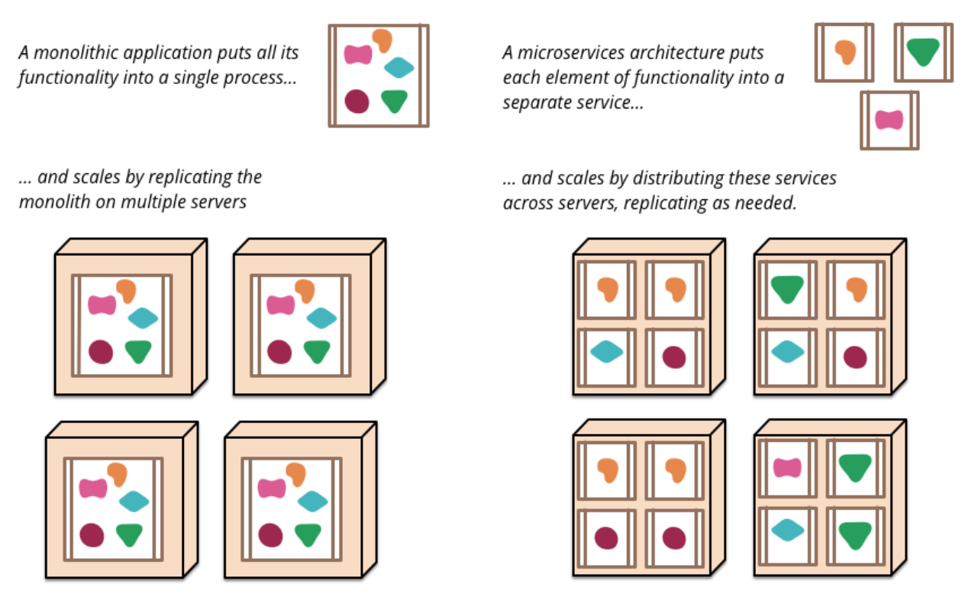
Monoliths vs Microservices https://www.martinfowler.com/articles/microservices.html

Slide 7
Characteristics of microservices
Independently deployable
Organized around business capabilities
Products not projects
API Focused
Smart endpoints and dumb pipes
Decentralized Governance
Decentralized Data Management
Infrastructure Automation
Design for failure
Evolutionary Design

Slide 8

Your journey to microservices…
DevOps
Infrastructure as Code (Self Service, Elastic, On-Demand)
Automation
(K8s, Chef, Puppet,..)
CI & CD Deployment Pipeline
Advanced Deployment Techniques

Slide 9
DevOps Overview: What & Why ?
Get a Free copy of "DevOps for Dummies" written by DevOps Gurus - Sanjeev Sharma and Bernie Coyne, after you register using the following link:
https://www.ibm.com/marketing/iwm/dre/signup?source=urx-15681&S_PKG=ov18162

Slide 10
What is DevOps
DevOps is a methodology that promotes collaboration to build, test, and deploy products rapidly with an emphasis on quality.
DevOps is the combination of Design, Development, Operations, and Testing through the implementation of automated pipelines that enable an environment of collaboration and continuous creation.
DevOps creates an atmosphere around speed and collaboration
DevOps enables the ability to fail fast and recover fast
DevOps is both a culture and a practice

Slide 11
Components in DevOps
Design – Organize Ideas, Plan Features, Set Goals, Assign Tasks
Build – Setup Configuration, Install dependencies, Compile, Provision Containers, VM, ..
Test – Unit, Integration & Systems Tests
Deploy – Push app to environment
Manage – Monitor Status, Log Events, Maintain App

Slide 12
DevOps Pipeline

Slide 13
DevOps – Complete Pipeline

Slide 14
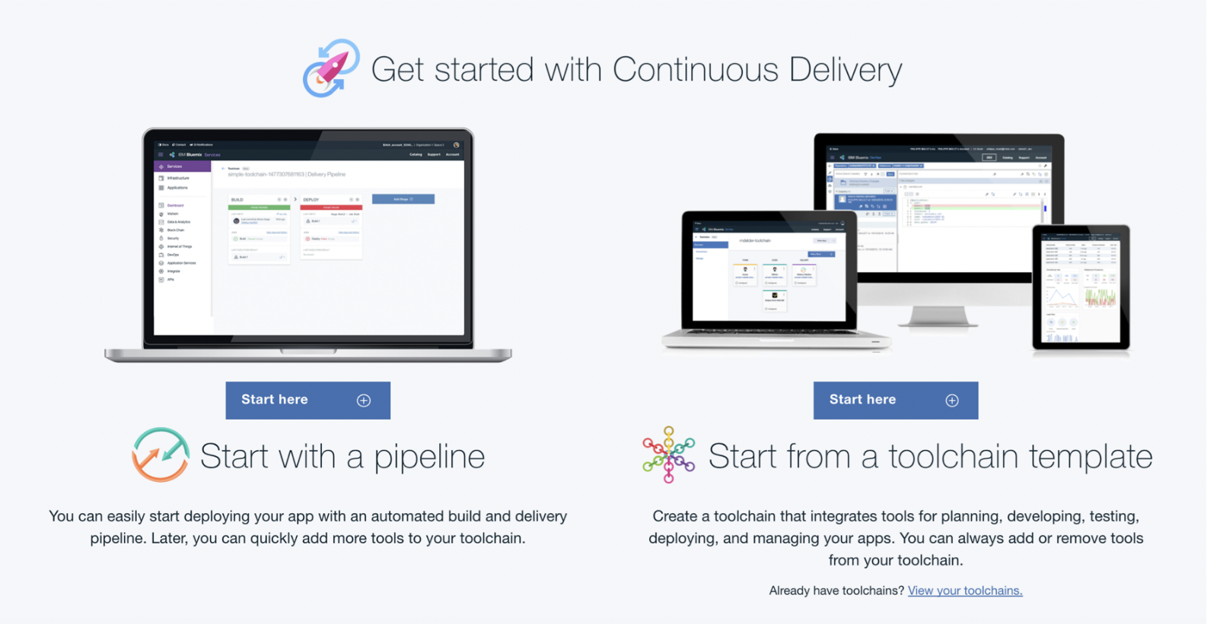





IBM Cloud Continuous Delivery
Create an integrated DevOps toolchain
Deliver continuously & manage composite
pipelines
Improve quality through insights
Edit your code from anywhere
Git repos & issue tracking
Speed with control

Slide 15
Simple Tool Chain Example

Slide 16

Containers: Why ?

Slide 17
Why Containers

Slide 18
VMs vs Containers

Slide 19
Containers - Advantages
Containers are a critical foundation for hybrid apps
Ship more software Accelerate development and CI/CD pipelines by eliminating headaches of setting up environments and dealing with differences between environments. On average, Docker users ship software 7X more frequently
Resource efficiency Lightweight containers run on a single machine and share the same OS kernel while images are layered file systems sharing common files to make efficient use of RAM and disk and start instantly
App portability Isolated containers package the application, dependencies and configurations together. These containers can then seamlessly move across environments and infrastructures

Slide 20
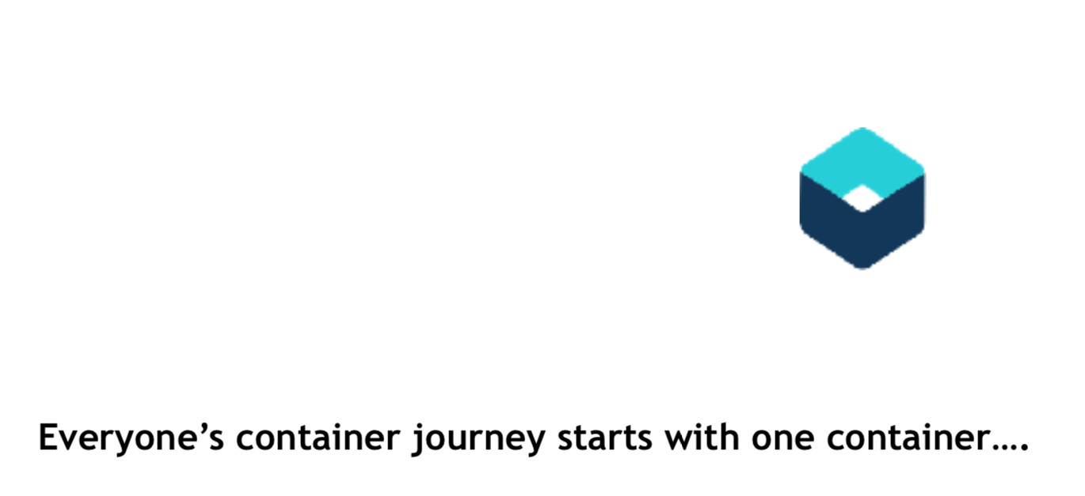

Slide 21
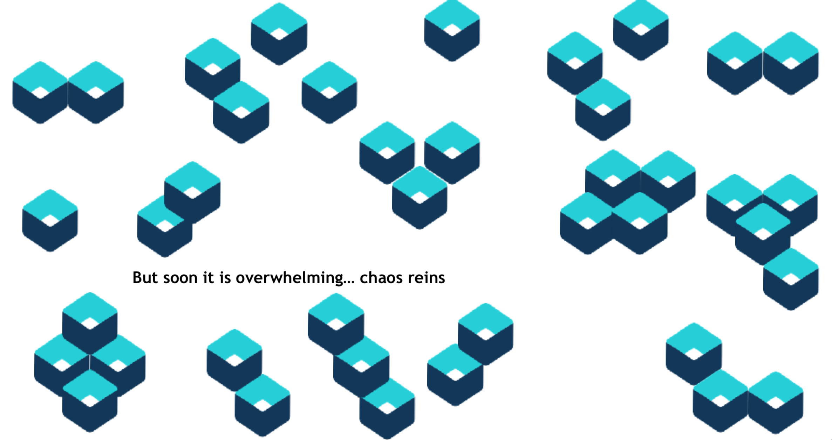

Slide 22
How to Gain Control…

Slide 23
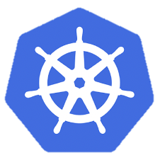
Kubernetes

Slide 24
What is Kubernetes
Container orchestrator Runs and manages containers Unified API for deploying web applications, batch jobs, and databases
Maintains and tracks the global view of the cluster Supports multiple cloud and bare-metal environments
Manage applications, not machines Rolling updates, canary deploys, and blue-green deployments
Designed for extensibility Rich ecosystem of plug-ins for scheduling, storage, networking
Open source project managed by the Linux Foundation Inspired and informed by Google's experiences and internal systems
100% open source, written in Go

Slide 26
IBM Cloud Container Service
Combines Docker and Kubernetes
Powerful tools Intuitive user experience Built-in security and isolation
Enables rapid delivery of applications
Leverages IBM Cloud Services
Including cognitive capabilities from Watson

